Slide 1
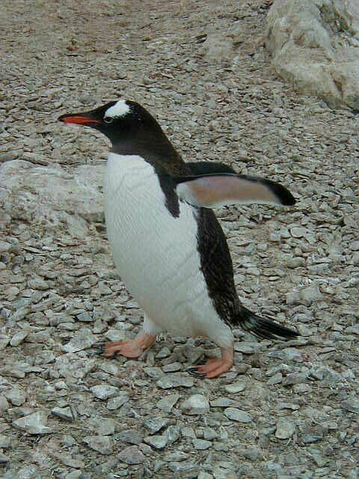
Penguins
By Mrs. Ferguson's Class

Slide 2

kyilee
Penguins are all black in white. And they cannot fly. There is a possible chance that they can bite but I don't know. They rip their food up .

Slide 3

ELLA
Penguins are amazing animals. They have solid bones.Penguins also can't fly but they fly
underwater. Penguins are always Black and
White no matter what.The black and white are
camouflage on penguins.

Slide 4
Tanner
Penguins are black and white.
They can't fly because they have solid bones.
All penguins live in the Southern Hemisphere and Antarctica
Penguins are very good swimmers
Emperor Penguins are a meter tall

Slide 5
Natalee
Penguins are black and white for camoflage
Penguins don't have hollow bones
They are flightless birds
There egg weighs a pound
They eat fish, krill,and squid
Killer whales and seals are the predators

Slide 6

Nathan
SUPERSTAR
WORK!
penguins have solid bones
penguins are camouflage
penguins live cold and hot weather
penguins are very fast swimmers
emperor penguins are over a meter tall
penguins can toboggan so they can go faster on land
penguins can weigh up to 90 pounds
there are a lot of species of penguins

Slide 7
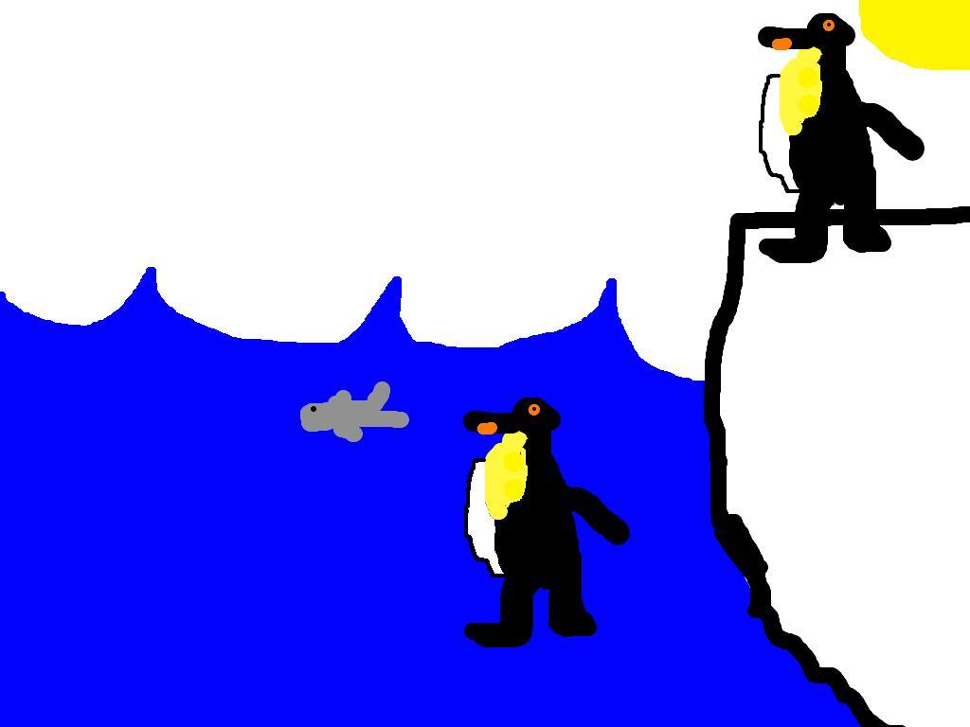
Benjamin
Penguins are black and white
animals that are very good at
swimming. They have solid bones so they cannot fly. Still there is no problem that they can't fly. They can slide on their stomachs on land, and they can swim really fast. Their favorite food is fish.

Slide 8

Evan
Penguins have solid bones.
Penguins are able to swim quickly away from predators.
They can hold their breath for 18 min.
They have camouflage to hide from predators.

Slide 9
Paul
Penguins don't have hollow bones
Penguins are black & white
Leopard seals eat penguins
Penguins eat fish,shrimp,& squid
Penguins cannot fly

Slide 10
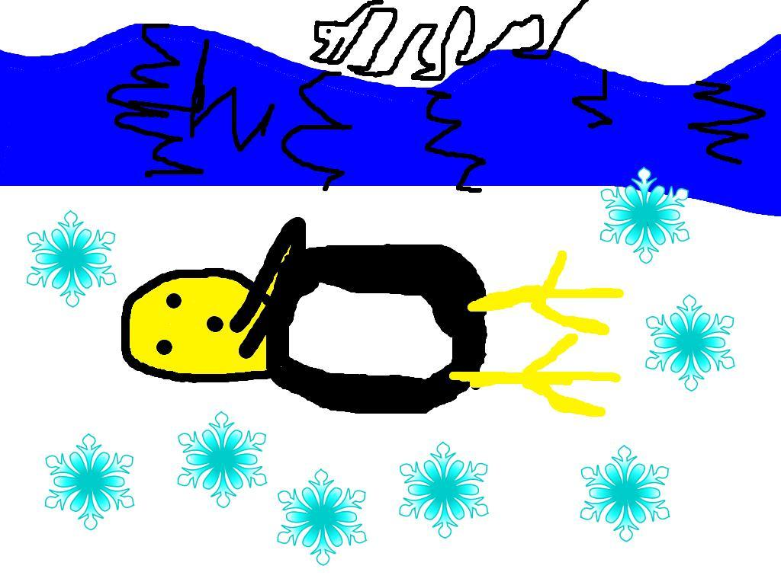
Baylor
Penguins have hollow bones
penguins walk slow on land
and fast in water
the black blends into water
and the white blends into snow
they eat fish and squid along with crustaceans

Slide 11
Alex
Penguins have a very interesting body .
One interesting fact is that a penguin has solid bones . Most birds don't have solid bones

Slide 12

Alex Hovey
All penguins live in the southern hemisphere
.2. all penguins are black and white but are not the same.
3.Penguins can't fly.

Slide 13
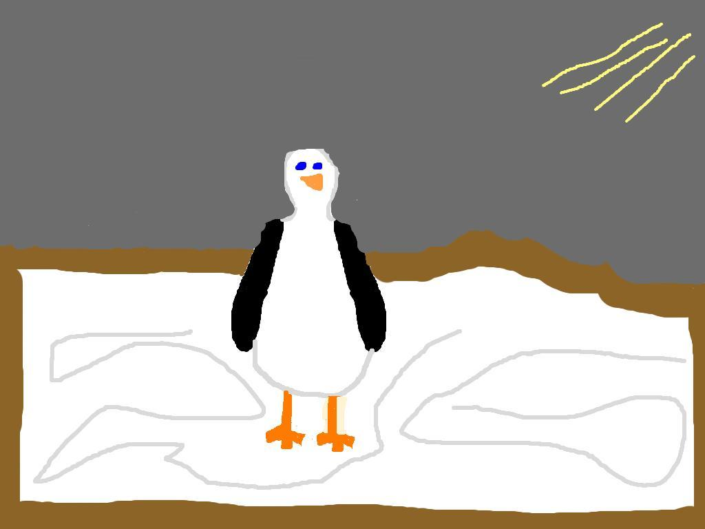
Tali
SUPERSTAR
WORK!
Penguins live in the Southern Hemisphere. They have solid bones and can't fly. The only time you would see one in the north is in the zoo. Penguins huddle to stay warm.Penguins are black and white.The penguin is black and white which camouflages it. Penguins live on cost lines too which means they can live in warm places.

Slide 14

Caleb
PENGUINS LIVE IN THE SOUTHERN HEMISPHERE
penguins have solid bones to help em swim under water
the emperor penguin might be taller than 1 meter
they eat a lot of fish
penguins do not live in the northern
hemisphere

Slide 15
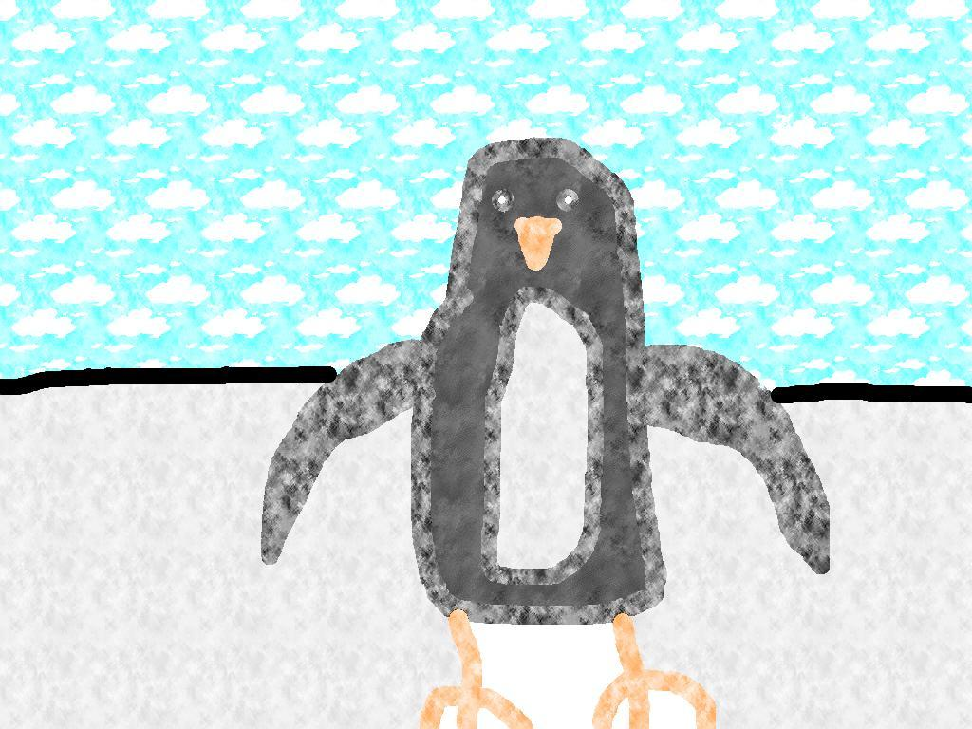
ANDRALYN #13
Penguins.......
Are carnivores because they eat fish
Have about 20 types of species
Are black and white
Can not fly
Do not have hollow bones
Are very fast swimmers but not very fast walkers

Slide 16
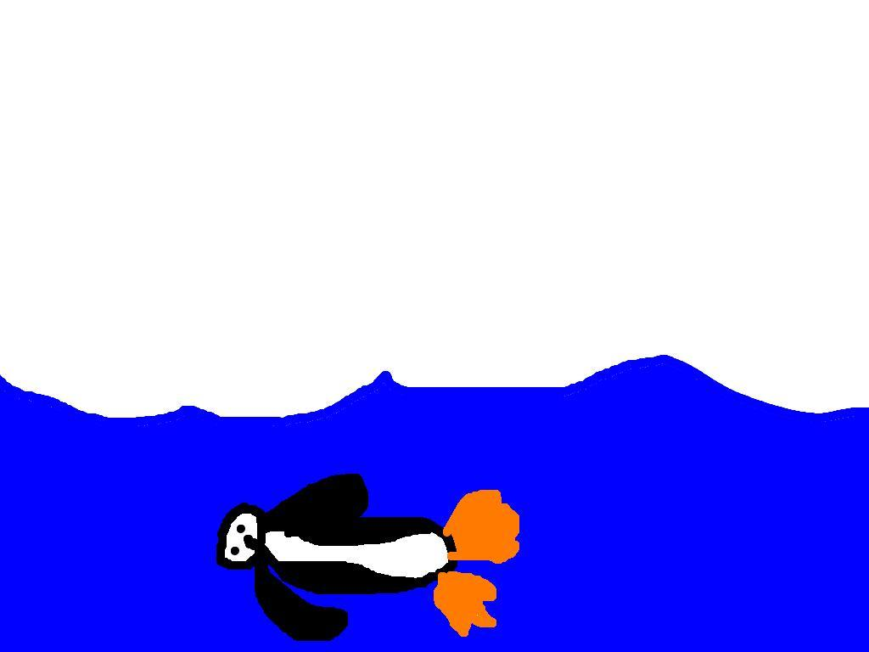
Taylor
All penguins have black and white because a sea lion could be on top of the penguin and it is darker looking down and the black is on top of the penguin. Then, the penguin will be hard to see. If the killer whale is on the bottom and the sun is shining it would be hard to see the penguin from the bottom. Also all penguins are black and white. But if the penguin doesn't know that the sea lion or the killer whale is there which is rare and it spins around they would both go after the penguin and would probably run into each other because the penguin is faster then them combined.

Slide 17
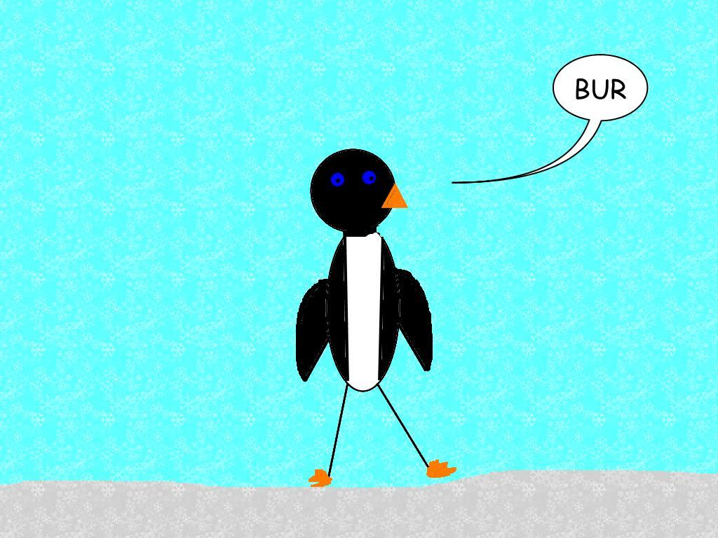
Renee
Penguins are black and white. This makes it so they blend into the water they swim in.If a predator looks down at the penguin the predator will only see black, this will blend into the sea or if a predator looks up at a penguin the penguin will blend in.The most heavy penguin humans have weighed is 90 pounds!

Slide 18
kailey
Did you know penguins have solid bones ?
All penguins can not fly no matter what.
penguins eat only fish and krill and some thing
else .penguins are black and white.
some day i wish i met a penguin.

Slide 19

Katherine
SUPERSTAR
WORK!
Penguins are very interesting animals.They have lots of different adaptations that help them survive in the Antarctic.They have webbed feet to help them swim fast to escape predators or catch their prey.There are 17 species of Penguins. The Emperor Penguin can be taller than a meter!Their eggs can weigh up to 1 pound.Penguins tabogon instead of walk because they are so slow. Penguins do not live in the Arctic or the northern hemisphere. Although they live in all the southern hemisphere except Australia.

Slide 20

Emily
Penguins have two things in common.They all live in the southern hemisphere and also they all are black and white.Did you know all penguins have solid bones?As you can see penguins are some interesting animals.

Slide 21

SARA.
Penguins have solid bones. Also they are black and white and they also have predators
like seals and killer whales. Penguins can't
fly like birds.

Slide 22
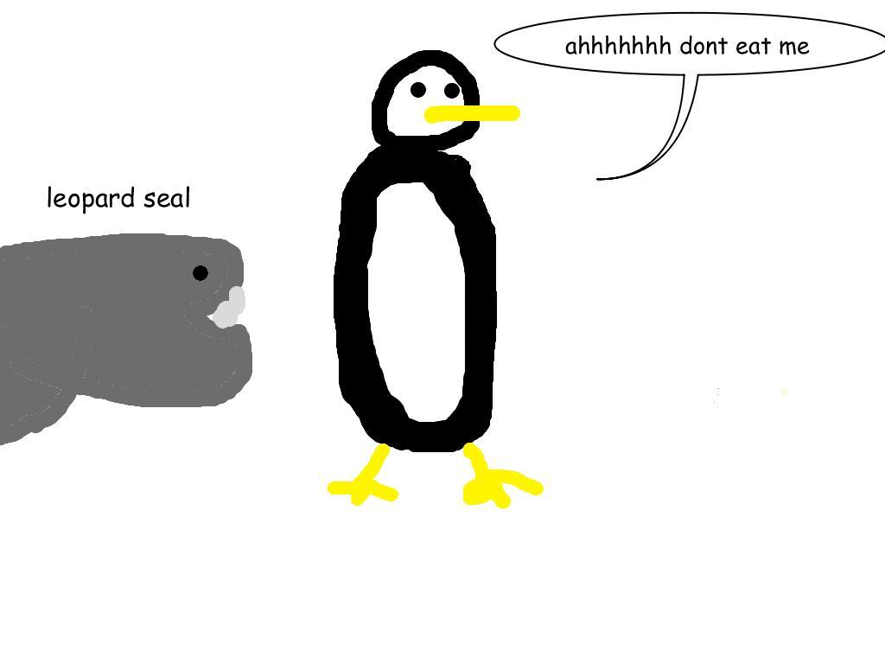
CHARLIE
They are black and white
They live in the southern hemisphere
They can't fly
They swim well
They eat fish
The Emperor penguins
are the tallest

Slide 23
Lexi
Penguins have solid bones
they are black and white
Penguins can swim very fast
The Emperor penguins is the biggest penguin

Slide 24
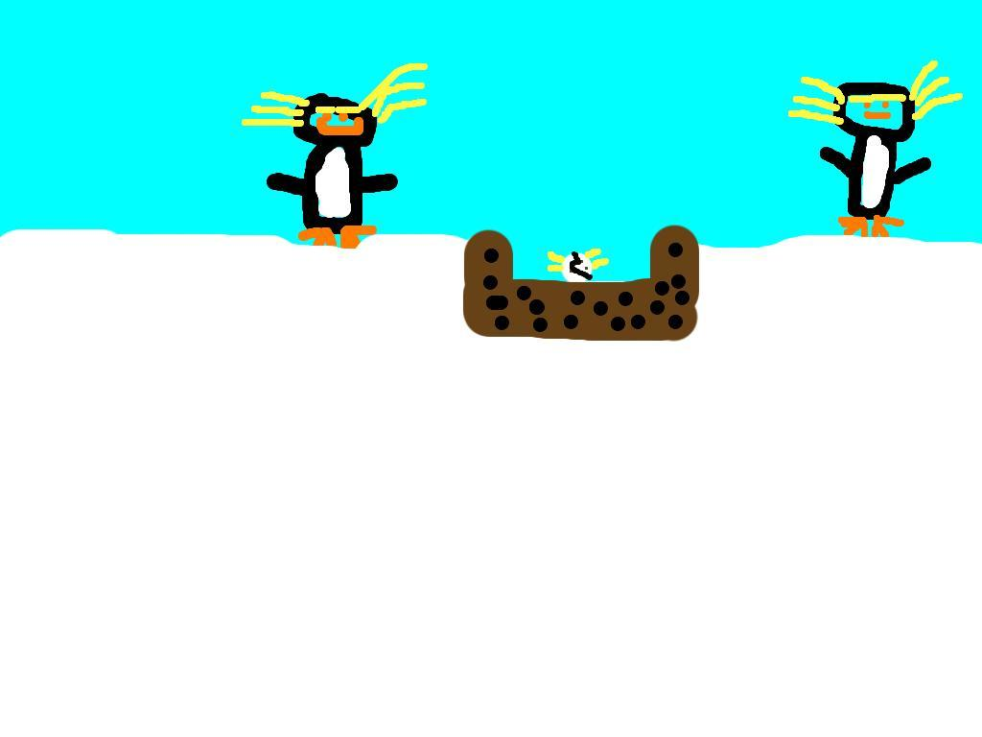
Addy
Penguins are black and white
They don't have hollow bones
They are birds but they can't fly
Their eggs can weigh up to a pound
They eat fish,krill, and squid
They can be taller than a meter
Penguins are camouflaged in the water
Their predators are killer whales and seals

Slide 25

hannah
Penguins have solid bone
they are black and white
they live in the south pole
they have webbed feet to swim faster
they eat mostly on fish

